Slide 1
Text Classification with Naïve Bayes* Text Analytics Nov 19, 2010 (Makeup Session)
*Slides based on article by H. Shimodaira, 2015

Slide 2
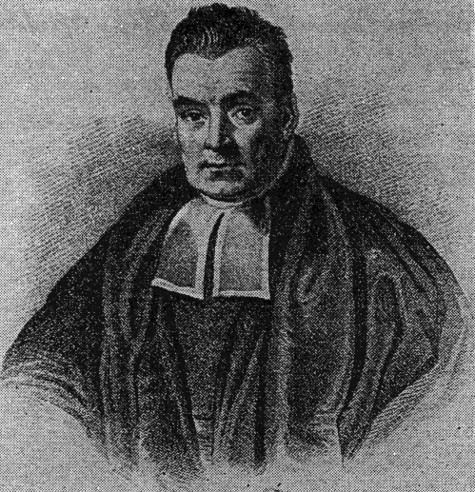
The Main Idea Behind Naïve Bayes
Why Naïve Bayes, esp. for text?
Revisiting the good old Bayes theorem
Which class C = s (spam) or h (ham) is document D?
Predictor features w₁, w₂, …, w_{n}
Bayes theorem: P(Class = s | w₁, w₂, …, w_{n}) =
Naïve Bayes makes a simplifying assumption
In Naïve Bayes, P(Class = s | w₁, w₂, …, w_{n}) =
But why make such an assumption?
Thomas Bayes
1702-1761

Slide 3
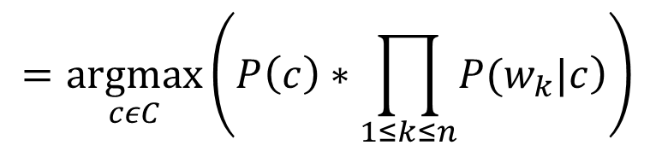
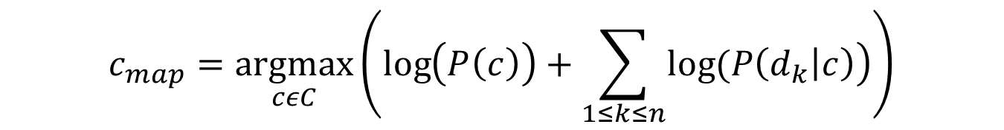
A General Formulation
$$c_{map}=\underset{cεC}{argmax}\left(P(c|D\right) α \underset{cεC}{argmax}\left(\left.P\left(c\right)∗P(D|c\right)\right)$$
$$=\underset{cεC}{argmax}\left(P\left(c\right)∗\prod_{1≤k≤n}{\left.P(w_{k}|c\right)}\right)$$
w_{k} is the kth term and n is the total number of terms
Conditional probability calculations depend on the assumptions
(e.g., Bernoulli vs. Multinomial)
Need to take log for computational purposes
$$c_{map}=\underset{cεC}{argmax}\left(\log\left(P\left(c\right)\right)+\sum_{1≤k≤n}{\left.log⁡(P\left(d_{k} | c\right)\right)}\right)$$

Slide 4
Naïve Bayes in Text Classification
Assumes a bag-of-words model
Vocabulary (or local dictionary)
V: E.g., {rock, pop, blues, jazz, music, like}
|V| word types (= 6 in this example)
Bernoulli vs. multinomial models
nltk has the Bernoulli version of Naïve Bayes
To get the multinomial version, use scikit-learn library
http://scikit-learn.org/stable/modules/generated/sklearn.naive_bayes.MultinomialNB.html
http://stackoverflow.com/questions/10098533/implementing-bag-of-words-naive-bayes-classifier-in-nltk
“I like rock music more than pop, but many of my friends are into pop music and not rock”
Bernoulli feature vector d^{B} =
Multinomial feature vector d^{M} =

Slide 5
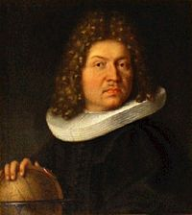
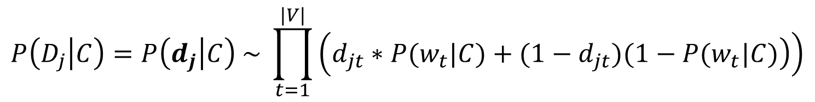

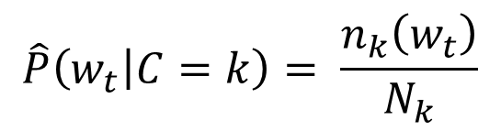
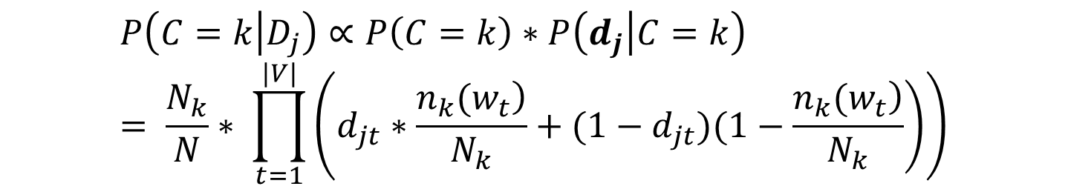
Bernoulli Document Model
Need to calculate P(C|D_{j})
Let’s use the Naïve Bayes assumption
Let d_{j} = feature vector of document D_{j}
Let the words (or terms) be {w₁, …., w_{|V|}}
d_{jt} is the t^{th} element in the feature vector d_{j} of D_{j}
Jacob Bernoulli
1654-1705
$$P\left(D_{j} | C\right)=P\left(d_{j} | C\right) \sim \prod_{t=1}^{|V|}{\left(\left.d_{jt}∗{P(w}_{t}|C)+(1−d_{jt})(1−{P(w}_{t}|C)\right)\right)}$$
N training documents, N_{k} of class C = k
n_{k}(w_{t}) = # documents in class k with word w_{t}
$$\hat{P}\left(w_{t} | C=k\right)= \frac{n_{k}\left(w_{t}\right)}{N_{k}}$$
$$\hat{P}(C=k)= \frac{N_{k}}{N}$$
$$P\left(C=k | D_{j}\right)∝P\left(C=k\right)∗P\left(d_{j} | C=k\right)= \frac{N_{k}}{N}∗ \prod_{t=1}^{|V|}{\left(\left.d_{jt}∗\frac{\left.n_{k}(w_{t}\right)}{N_{k}}+(1−d_{jt})(1−\frac{\left.n_{k}(w_{t}\right)}{N_{k}}\right)\right)}$$

Slide 6
Example
Class = S (sports) or I (IT), |V| = 8
1 0 0 0 1 1 1 1
0 0 1 0 1 1 0 0
0 1 0 1 0 1 1 0
1 0 0 1 0 1 0 1
1 0 0 0 1 0 1 1
0 0 1 1 0 0 1 1
0 1 1 0 0 0 1 0
1 1 0 1 0 0 1 1
0 1 1 0 0 1 0 0
0 0 0 0 0 0 0 0
0 0 1 0 1 0 1 0
D^{S} =
D^{I} =
Classify
1. d₁ = (1, 0, 0, 1, 1, 1, 0, 1)^{T} 2. d₂ = (0, 1, 1, 0, 1, 0, 1, 0)^{T}

Slide 7
The Multinomial Case
Actual word frequency, not just 0/1
Revisiting the multinomial distribution
In how many ways can you arrange the word “Mississippi”?

Slide 8
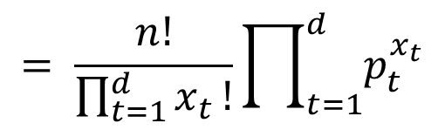
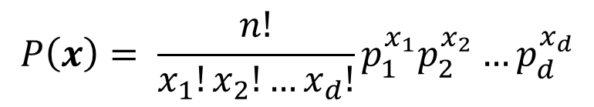
The Multinomial Distribution
n items of d types
x₁, x₂, etc. of type 1, 2, etc.
How many distinct permutations?
n items are drawn at random (with replacement) and let x_{t} denote the number of items of type t.
p_{t} = proportion of items of type t
The vector x = (x₁, . . . , x_{d})^{T} has a multinomial distribution with pmf
$$P\left(x\right)= \frac{n!}{x_{1}!x_{2}!…x_{d}!}p_{1}^{x_{1}}p_{2}^{x_{2}}…p_{d}^{x_{d}}$$
$$= \frac{n!}{\prod_{t=1}^{d}{x_{t}}!}\prod_{t=1}^{d}{p_{t}^{x_{t}}}$$

Slide 9
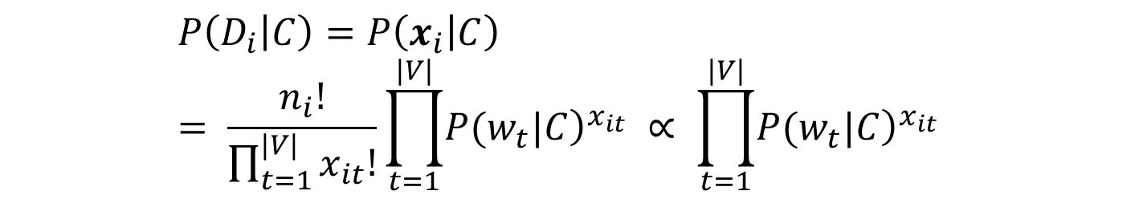
Using Multinominal Representation for Document Classification
Let x_{i} be the multinomial model feature vector for the ith document D_{i}
x_{it} is the t^{th} element of x_{i}
Let n_{i} = Ʃ_{t} x_{it} = total number of words in document D_{i}
$$P\left(D_{i} | C\right)=P\left(x_{i} | C\right)= \frac{n_{i}!}{\prod_{t=1}^{|V|}{x_{it}!}}\prod_{t=1}^{|V|}{{\left.P(w_{t}|C\right)}^{x_{it}} ∝ \prod_{t=1}^{|V|}{{\left.P(w_{t}|C\right)}^{x_{it}} }}$$

Slide 10
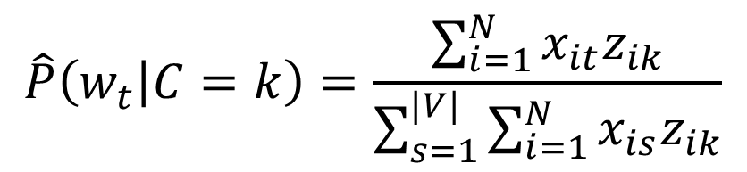
Estimating the Probabilities
z_{ik} = 1 if D_{i} has class = k, 0 otherwise
$$\hat{P}\left(w_{t} | C=k\right)=\frac{\sum_{i=1}^{N}{x_{it}z_{ik}}}{\sum_{s=1}^{|V|}{\sum_{i=1}^{N}{x_{is}z_{ik}}}}$$

Slide 11
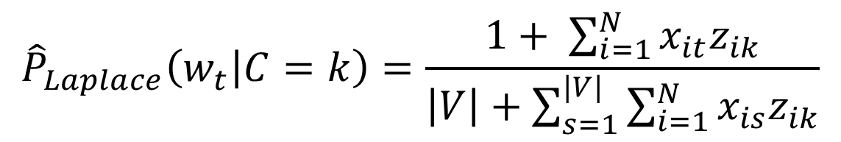
Absence of Words in Training Data
The problem
A solution
$${\hat{P}}_{Laplace}\left(w_{t} | C=k\right)=\frac{1+ \sum_{i=1}^{N}{x_{it}z_{ik}}}{\left|V\right|+\sum_{s=1}^{|V|}{\sum_{i=1}^{N}{x_{is}z_{ik}}}}$$

